Slide 1



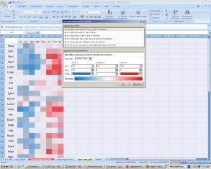
Figure 5
A
B
C
-2 log2 2
-2 log2 2
-2 log2 2

